Slide 1
Project Five
CLEAN DATE
By
Ebenezer Mensah

Slide 2
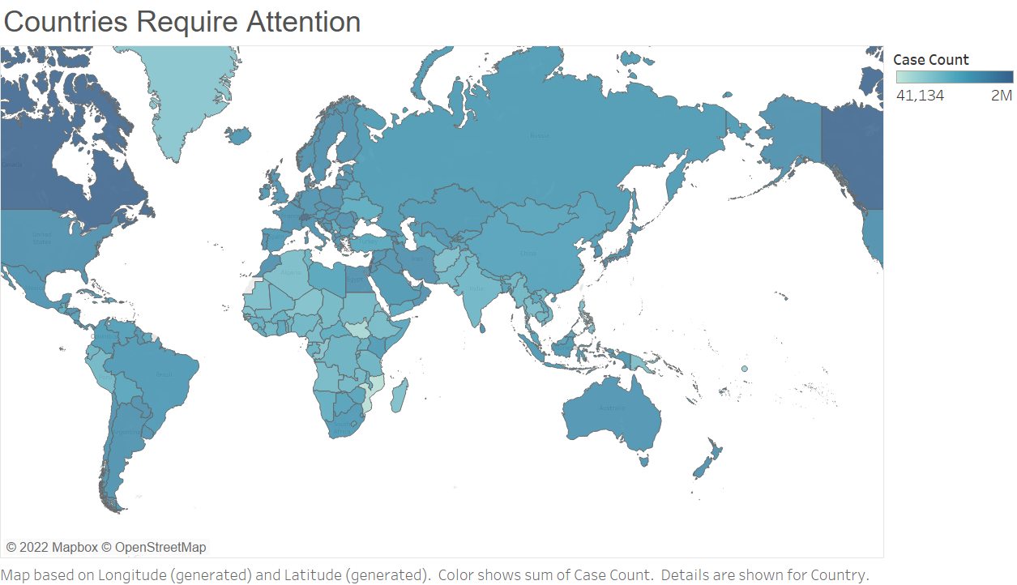
Countries Require Attention
Looking at the countries. We can see that Canada has the highest cases. Due to the peak of its color. America and Russia are pretty high too.

Slide 3
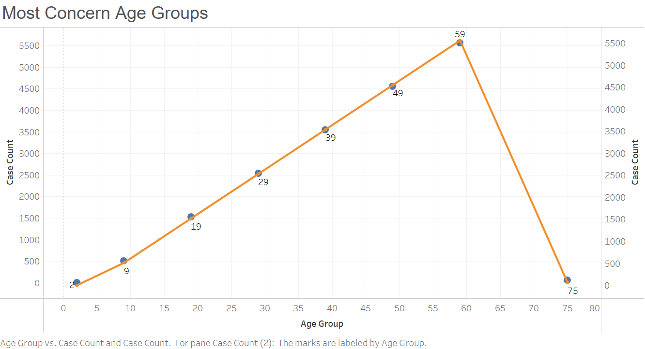
Most Concern Age Group
Looking at the graph, we noticed that. The older you are, the higher your chances are you to get be positive. But there is a big decrease from 60 to 75. I think it's because there are more last people in the age of 60 to 75. If all things being equal, we would have seen the slope still raising.

Slide 4
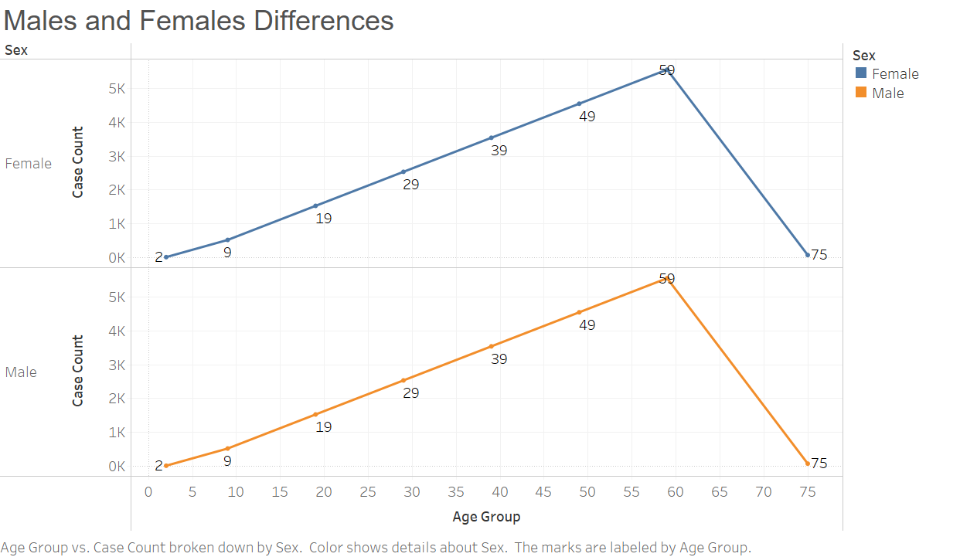
Male and Female Differences
Looking at the graph. We can see that, there is not much difference between male and female. We can conclude that, it that's not matter if you are a male or a female the positive cases are very similar.

Slide 5
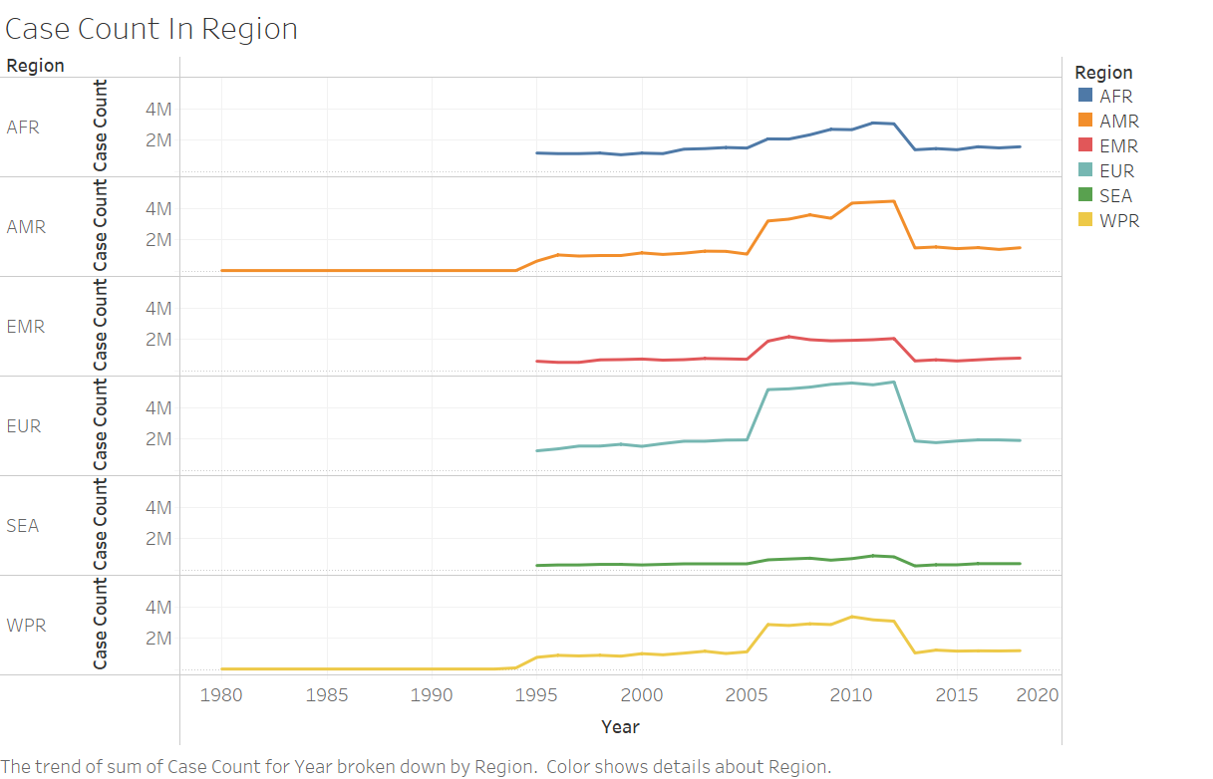
Case Count In Region
Looking at the graph we can note that Europe hit its peak around 2012 and they record the most highly cases, followed by America. In Europe the peak leasted for almost 7 years, from 2005 to 2012.

Slide 6

As a software engineer major. I will say the future data science programming language should be python. Because it's the easiest to learn and as a whole, if we need people to do more, we need to get them the easiest way.

Slide 7
Wrangling In The Date
In the first date which was shared, the date was not clear. It needed clear variables which describe what the elements really means. Eg: child_age is a good one verse uhuh_hvv_hbh which don’t make any sense.
And most of the elements were empty. There was not enough date to generate any meaningful visuals.

Slide 8
THE
END

